Slide 1
Juniper Networks
Unleashing Network Potential through SDN on Virtual Networking Lab Environments
Pilar Somohano
General Manager - Virtual Junos Business Unit

Slide 2
Facing Cable Industry CHALLENGES
Fast deployment / low cost delivery methods, add pressures to cable providers in terms of cost, time, bandwidth and service diversity
Revenue Sources
Cost Drivers
Optimization Enablers
DEVICES
SUBSCRIBERS
Quick activation of subscribers
Automation
Multi-device delivery
Simplify implementation
Prevent errors
Accelerate development
Facilitate operation
Optimize performance
Virtual Networking
SERVICES
Introduction and expansion of services
NETWORK
SDN

Slide 3
Virtualization role on optimization lab test of SDN and automation
SDN helps operators to optimize cost performance by introducing adaptive networking and increase revenues by enabling new advanced services and dynamic service chaining. SDN facilitates smart distribution, and boosts network potential.
Automation accelerates configuration of new nodes, users and services, and can also contribute to reduce implementation errors.
Virtual networking lab environments allow for true scale testing for reliable development of services and creation of automation templates, scripts and tools.
Virtual
Networking
Automation
Virtual Networking Labs enable reliable and efficient implementation of SDN and automation
SDN

Slide 4
Overview of SDN

Slide 5
Sdn Principles
Separation of networking functional blocks to create modular service development through balanced centralized/distributed deployment of these functions
Network Management
Unified network operation
Smart discovery and orchestration
Services Plane
Accelerate creation of differentiated services
Multi-source platforms
Network Management
Unified network operation
Smart discovery and orchestration
Control Plane
Simplify network configuration
Dynamic route optimization
Forwarding Functions
Maximize bitrate forwarding performance
Minimize power consumption and footprint
Network Management
Services Plane
Accelerate creation of differentiated services
Multi-source platforms
Services Plane
Control Plane
Control Plane
Simplify network configuration
Dynamic route optimization
local control
local control
Forwarding Functions
Maximize bitrate forwarding performance
Minimize power consumption and footprint
Forwarding
Functions

Slide 6
SDN Example Service chaining in action
Gaming DC
Shift content to SVL
CoI in SVL
VM
VM
VM
CONTROLLER
NETWORK INTELLIGENCE
John has started playing
John has started playing
Andy & Joe joined John
John logged in from SFO
Andy & Joe logged in from SVL
John’s new profile:
High BW
Low latency
Don’t bill volume
John starts gaming service
SP DC
VM
VM
Andy & Joe’s new profile:
High BW
Low latency
Don’t bill volume
John resumes gaming service
Content delivered locally
BNG
P-GW
John connects from home
Andy & Joe join the game
John goes to office
Logs in from his tablet
Notes:
BNG = Broadband Network Gateway
BNG is the access point for subscribers, it connects the Customer Premises Equipment (CPE) to broadband services.
BNG establishes and manages subscriber sessions and aggregates traffic from various subscriber sessions. It controls subscriber management functions such as:
- Authentication, authorization and accounting of subscriber sessions
- Address assignment
- Security
- Policy management
- Quality of Service (QoS)

Slide 7
Step by step implementation
Use of a virtual lab for network optimization

Slide 8
Lab practices today Planning, deployment and maintenance
Today…
How much time does it take you to set a test environment to verify new services or automation scripts?
How often do you test these elements at on a large scale environment
Is it feasible to test at a large scale on a network with the same properties as the production environment… and do so efficiently?
What do you do when the network experiences problems?... do you have time to verify the fix before pushing it into production?

Slide 9
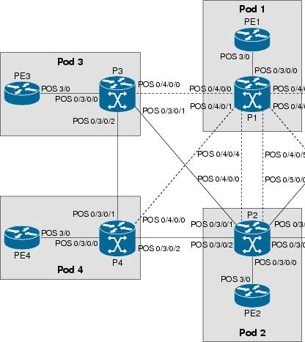
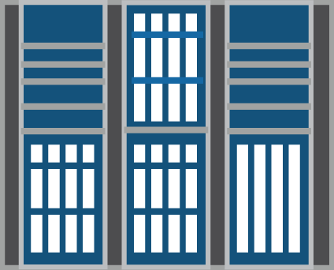
Step 1 capture the production network
The Network Capture technology allows for quick replication of the production environment in the virtual lab to facilitate planning, test of automated procedures, and conduct efficient operational pre-tests for services.
Production Environment
Network Management System
Capture Application
Lab Environment
Virtual networking lab
Physical equipment
Next-gen lab automation method, patented by Juniper, boosts operational efficiency

Slide 10
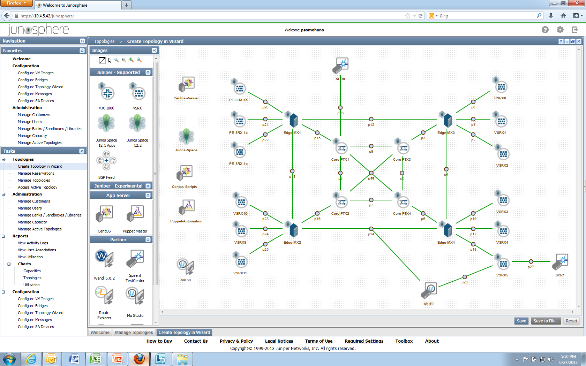
Step 2 add tools and nodes to network capture
Case 1: Test automated configuration to add new subscribers on any access node
Case 2: Test automation to enable a service to a subscriber
Config automation can use:
Templates on Management System
Custom Linux scripts
Puppet tools
Automated configurations can be applied to new network nodes:
- Access router, security devices
Create modified copies of the topology to test “what-if” scenarios
After automation runs, tests must be performed using:
Ecosystem tools
Junos Space alarms / information

Slide 11
Step 3 develop and test virtual services WITH VIRTUAL app Engine
Scale testing of tethered services, and service chaining, using a hybrid virtual-to-physical connector
Run and test new services on a centralized services engine

Slide 12
Step 4 Test and correct on virtual lab
Run test scripts using APIs to control test equipment
Generate traffic and test proper operation of protocols and policies at scale
Run batch process to apply config templates to multiple nodes
Load Space SDKs on Centos server
Revise configurations and automation tools to eliminate errors

Slide 13
Step 5 add the Tested methods into production
Topologies | Scripts | Templates | Configurations
Topologies are stored as efficient zip files that can be shared within Junosphere sandboxes. Topologies can be reused multiple times, copied, and analyzed by diverse teams. | All scripts can be uploaded and downloaded between the user’s machine and the instance in Junosphere’s sandbox via FTP. The corrected scripts can be copied and passed from the development team to the engineering and implementation teams. | The revised templates from the Space instance in Junosphere, can be transferred to the Space system on the production network. | With new developments to the VMX, users will be able to run the same configuration file in Junosphere and their physical nodes.
All network, configuration and automation information can be shared transparently from automation and architecture design to the engineering and operation teams. All teams have copies of the test files, and can easily submit specific / reproducible feedback when they detect issues.
Pre-production
Production
Planning & Design
Subscriber & Service activation
Operation and troubleshooting

Slide 14
Pilar Somohano
General Manager – Virtual Junos Business Unit
psomohano@juniper.net
978-589-0320

Slide 15
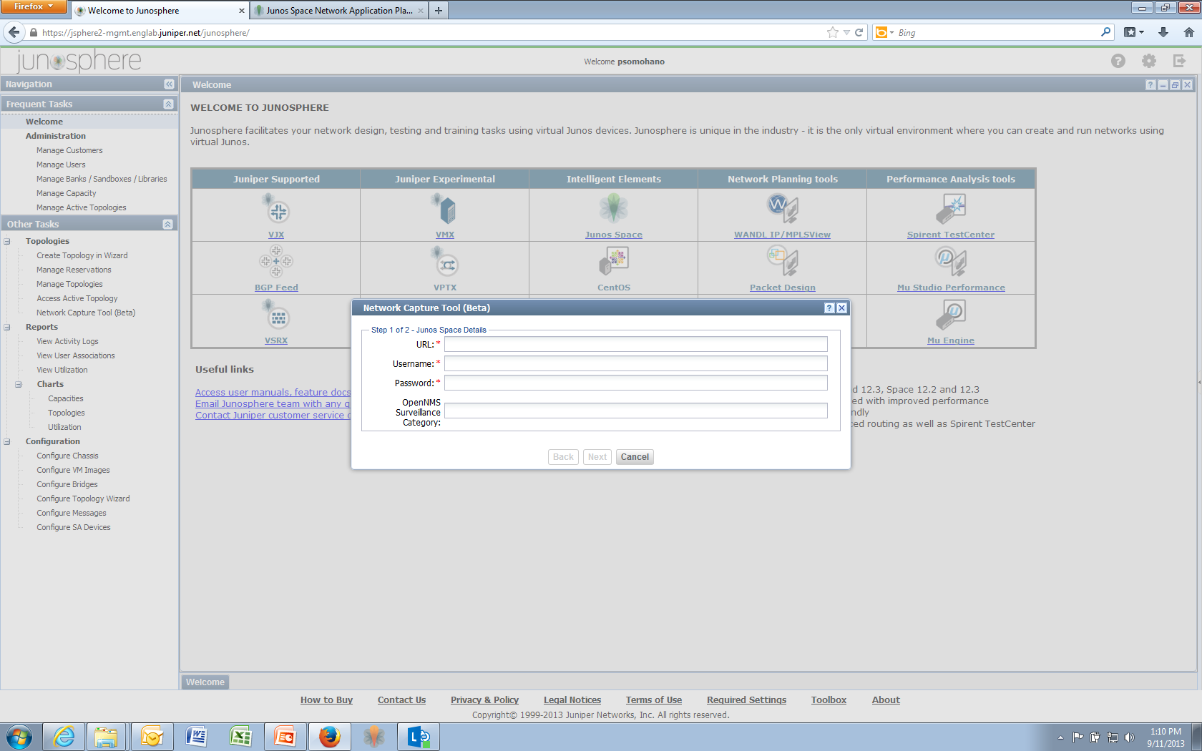
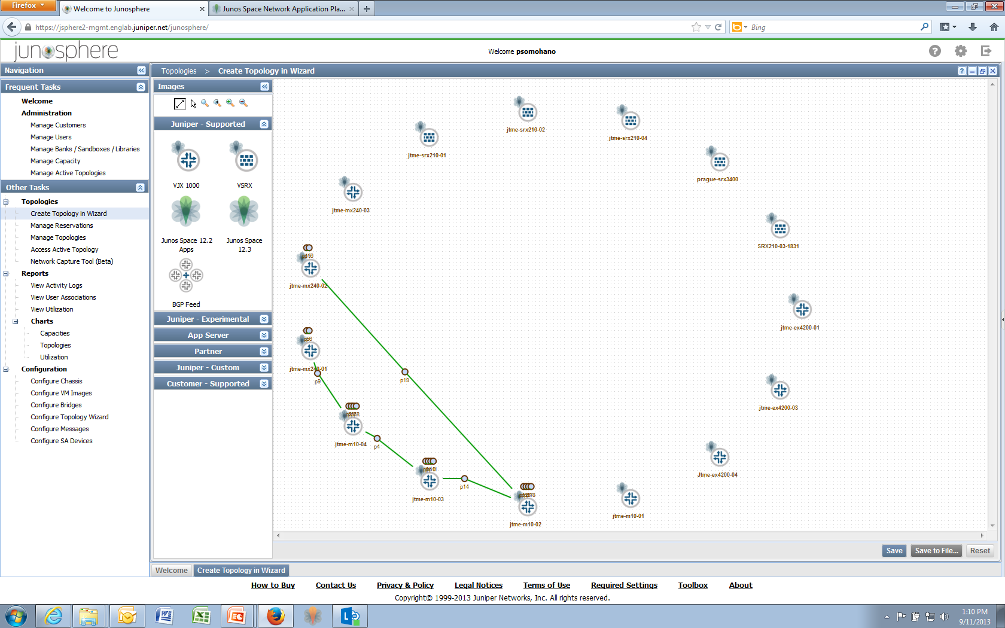
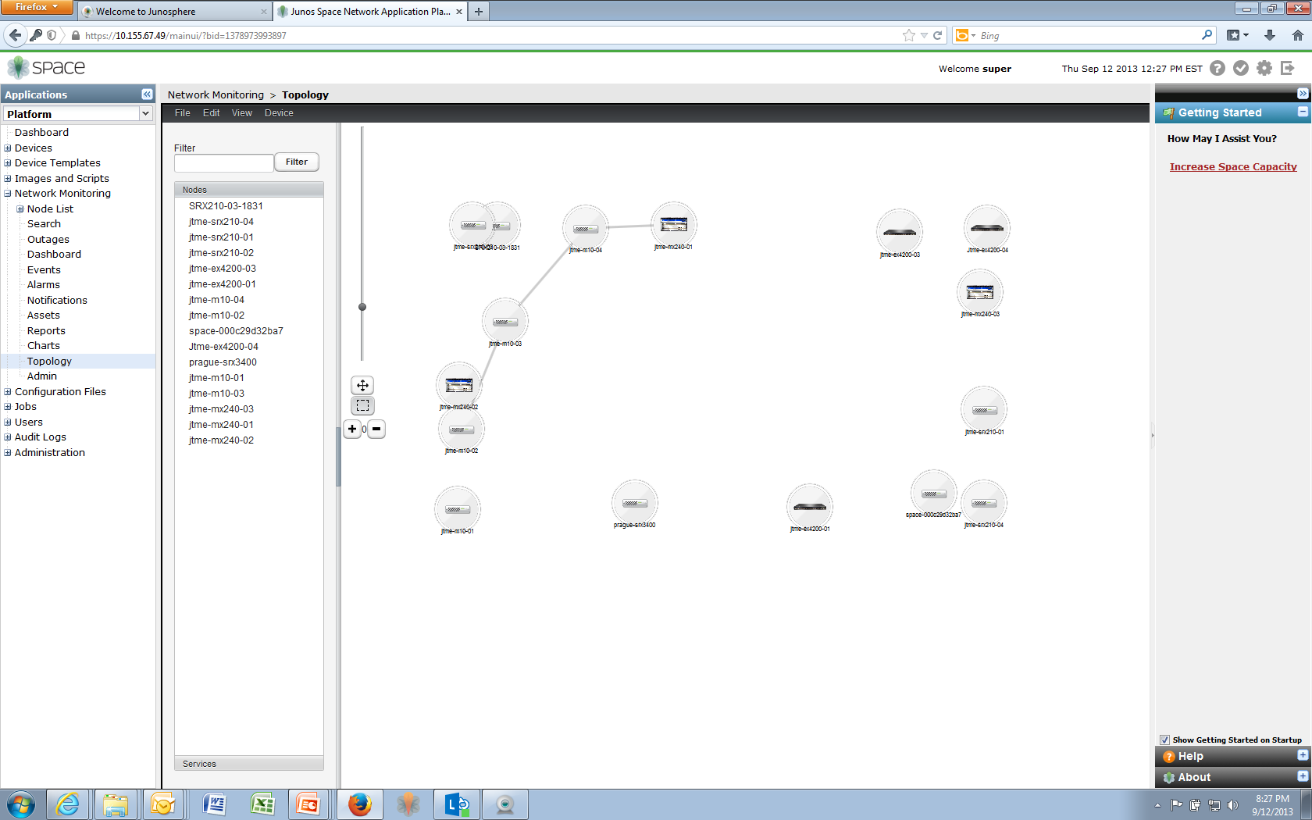
Network Capture Tool
Notes:
https://jsphere2-mgmt.englab.juniper.net/junosphere/
Space URL - https://10.155.67.49
Username/Password – super/juniper123

Slide 16
Efficient planning, implementation and operation VIRTUAL NETWORKING LAB approach
Goals:
Reduce costly errors
Accelerate implementation
Control costs
Tasks:
Verify releases and configurations before implementation
Troubleshoot large scale networks
Train personnel
Approach:
A virtual environment that supports network creation
Enable scalability cost-effectively
Deliver true network replication

Slide 17
Service chaining model
Service Mgt/Control
Service
Policy
State and Event Sync
Router
A
SC1
Service
Node1
Service
Node1
Router
B
Service
Node 3
Service
Attachment
Point
Service Tunnel
Service
Node 2
Service
Node 3
Service
Node 3
SC2
Aggregate
Service Tunnel
Service
Interfaces
SC3
SC4
1) A Service Chain is a sequence Service Nodes connected via Service Tunnels.
2) A Service Chain originates and terminates at a Service Attachment Point
Virtual Network (VNS), Zone/Filter in a Router, etc.
3) Service Chains can be uni or bi-directional
Managed by the Controller
Symmetric hash and Flow Tables
4) A Service Chain is mapped to a Service Interface in the Service Nodes
5) Dynamic steering: Service selects appropriate egress interface
6) Load Distribution is done by an aggregate of Service Tunnels going to a set of Service Nodes (e.g. TLB with programmable Consistent Hash)

Slide 18
Application cases

Slide 19
More application cases
 | Case 1 | Case 2 | Case 3
Application | Implementation of a new MPLS supercore | Analysis of migration from multiple AS to unified AS environment | Scalability tests for hardware performance
Pre-sale work | Using over-time analysis of traffic growth projections with network planning tool, the team compared the cost of new vs. traditional solutions to identify the most efficient approach | There are advantages and disadvantages associated to one approach vs. the other. Junosphere is used to model an entire network to identify objectively what is the best approach | For homologation tests of new equipment, Junosphere can replicate conditions of the production environment, and allow for connection between he virtual network and the physical lab to stress-test physical equipment prior to deployment
Post-sale application | Large-scale model to validate topological (data plane) and architectural (control plane) design to facilitate the addition of the new supercore
Benefits | The network modeling work helped identify the best choice, and the pre-implementation modeling accelerated service turnup. | A change like this implies a large investment of time and a risk… comparing the two approaches before implementation leads to an optimum outcome and reduced risks. | Reduces the CAPEX needed to conduct the tests and accelerates time to sell

Slide 20
From design to Test to implementation Smooth process flow
Juniper’s automation solution based on Junos + Space + Junosphere:
The environment that reflects dynamically the production network throughout its full life cycle
Facilitates the communication flows of all teams involved on managing this life cycle using a common environment that facilitates handshake sharing of network information between teams, and yet maintains operational independence.
Pre-production
Production
Planning & Design
Subscriber & Service activation
Operation and troubleshooting
Automation Process Flow

Slide 21
virtual networking lab environment Architecture
User interface
Access via web browser
Topology isolation
Independent, secure cloud silo for each customer
User A
SSL VPN
User B
Junosphere Connector
Secure tunnel to physical network lab

